Slide 1


OCP 11 Part 1 [1Z0-819]
Dr.-Ing Mohamed Amine Mezghich
Associate Professor at ENSI, CEO of Smart IT Partner
JAVA/J2EE Certified Trainer
ma.mezghich@smart-it-partner.com
amine.mezghich@ensi-uma.tn

Slide 2
Chapter 6:Exceptions
OCA EXAM OBJECTIVES COVERED IN THIS CHAPTER: ✓ Handling Exceptions ■ Differentiate among checked exceptions, unchecked exceptions and Errors ■ Create a try-catch block and determine how exceptions alter normal program flow ■ Describe the advantages of Exception handling ■ Create and invoke a method that throws an exception ■ Recognize common exception classes (such as NullPointerException, ArithmeticException, ArrayIndexOutOfBoundsException, ClassCastException)

Slide 3
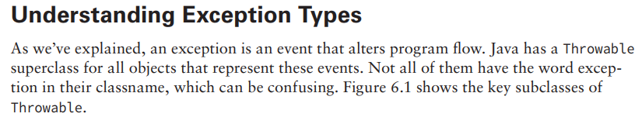
1-Understanding Exceptions

Slide 4
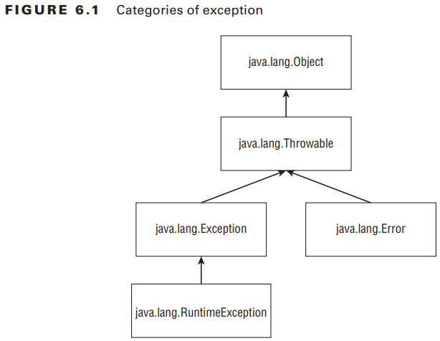
1-Understanding Exceptions

Slide 5
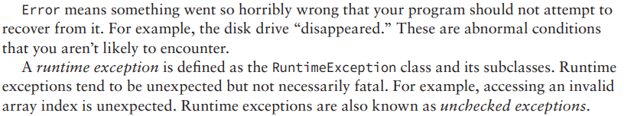
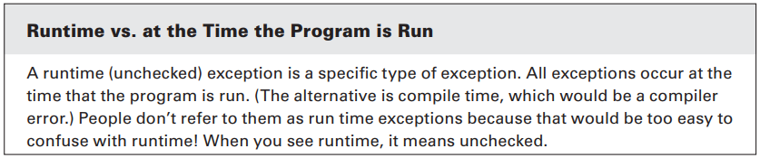
1-Understanding Exceptions

Slide 6
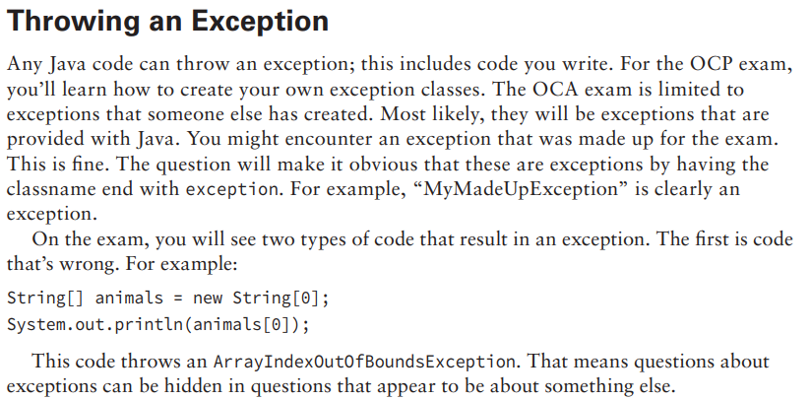
1-Understanding Exceptions

Slide 7
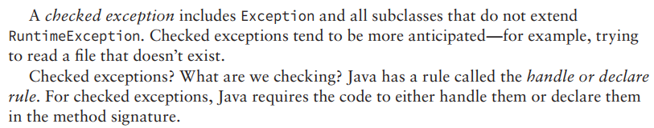
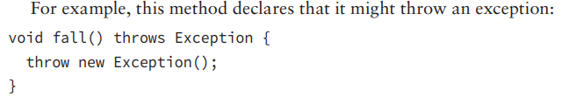
1-Understanding Exceptions

Slide 8
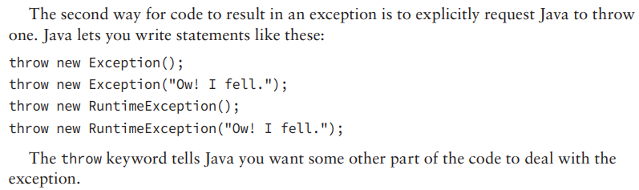
1-Understanding Exceptions

Slide 9
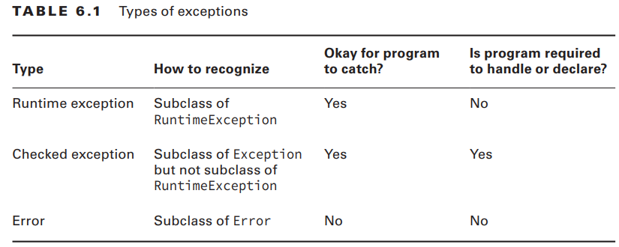
1-Understanding Exceptions

Slide 10

2-Using a try Statement

Slide 11
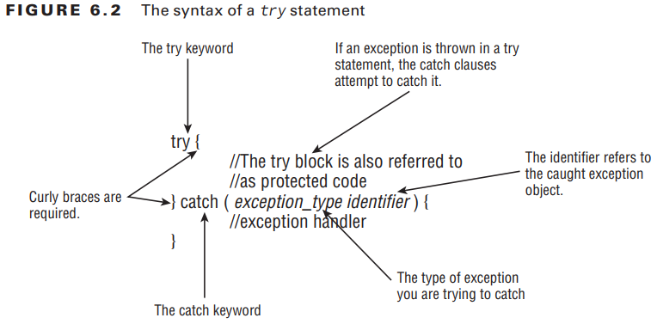
2-Using a try Statement

Slide 12
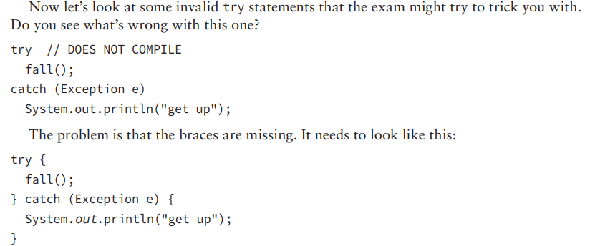
2-Using a try Statement

Slide 13
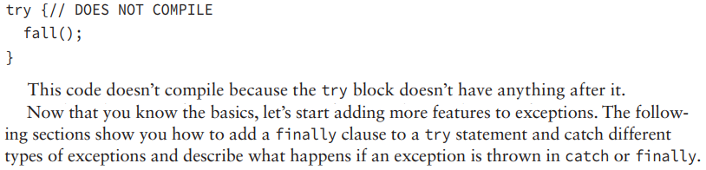
2-Using a try Statement

Slide 14
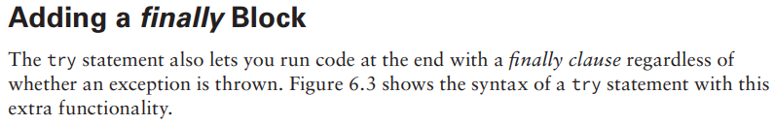
2-Using a try Statement

Slide 15
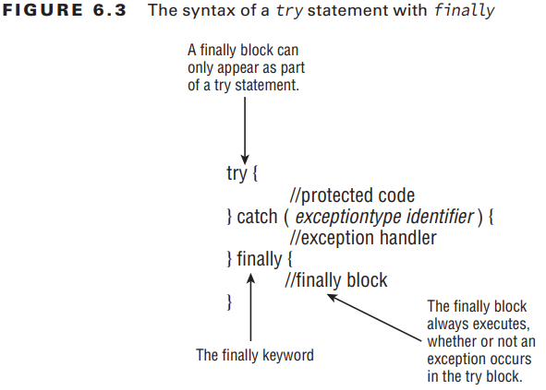
2-Using a try Statement

Slide 16
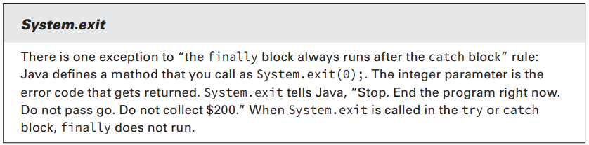
2-Using a try Statement

Slide 17
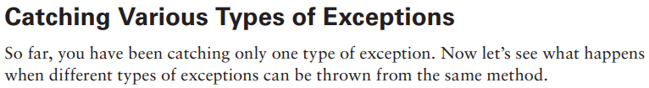
2-Using a try Statement

Slide 18
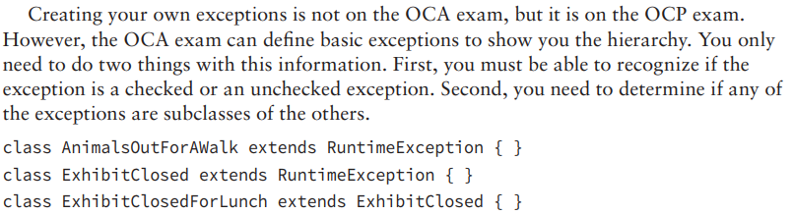
2-Using a try Statement

Slide 19
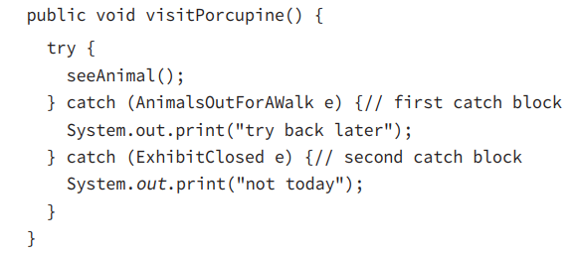
2-Using a try Statement

Slide 20
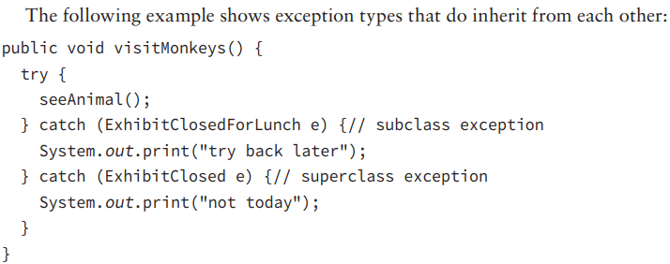
2-Using a try Statement

Slide 21
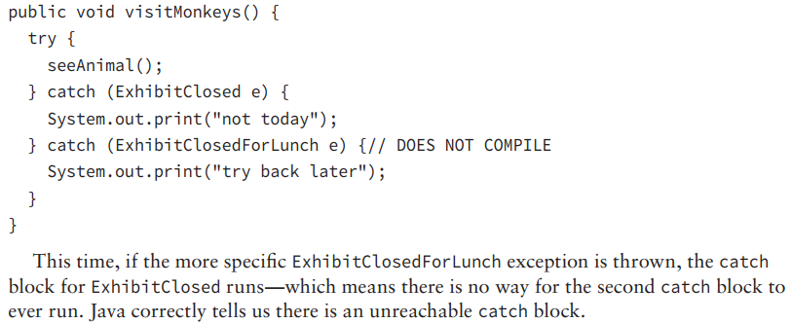
2-Using a try Statement

Slide 22
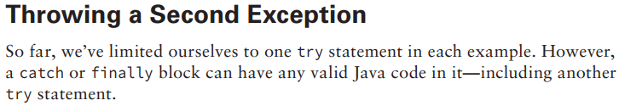
2-Using a try Statement

Slide 23
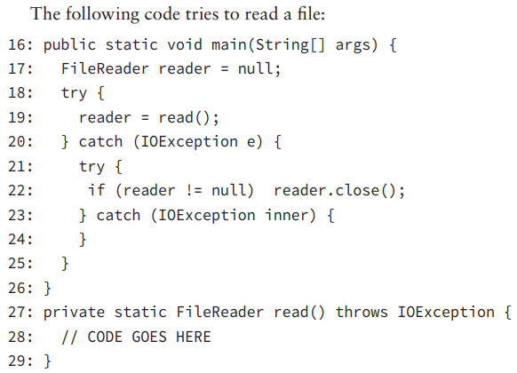
2-Using a try Statement

Slide 24
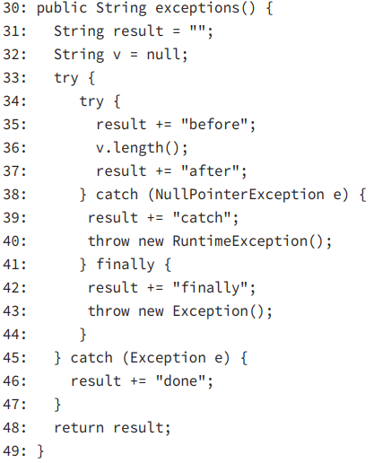
2-Using a try Statement

Slide 25
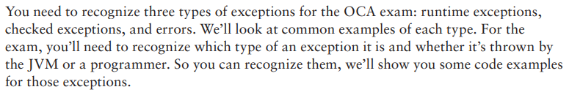
3-Recognizing Common Exception Types

Slide 26
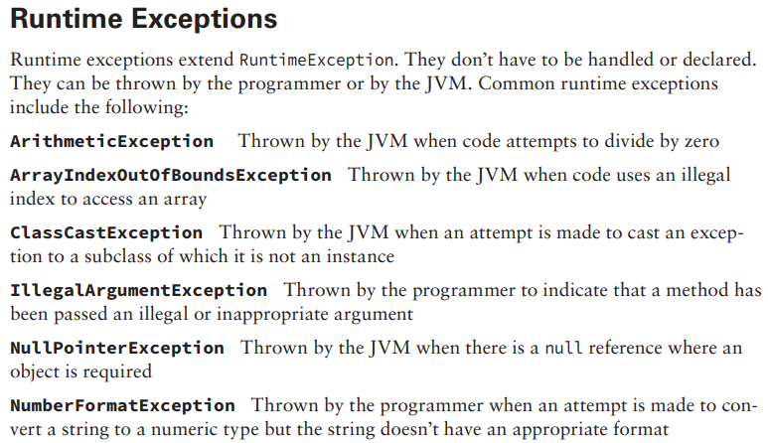
3-Recognizing Common Exception Types

Slide 27
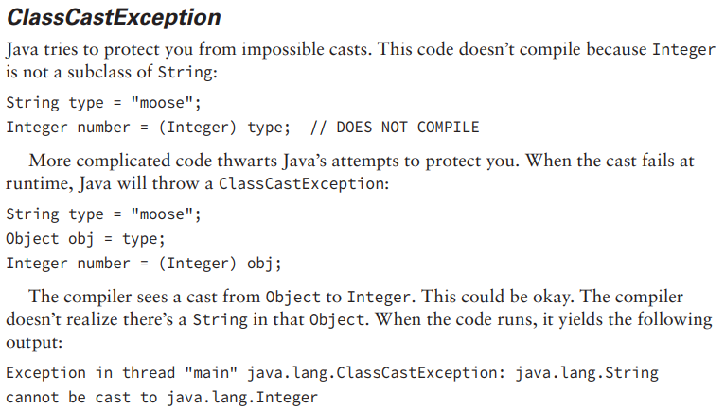
3-Recognizing Common Exception Types

Slide 28
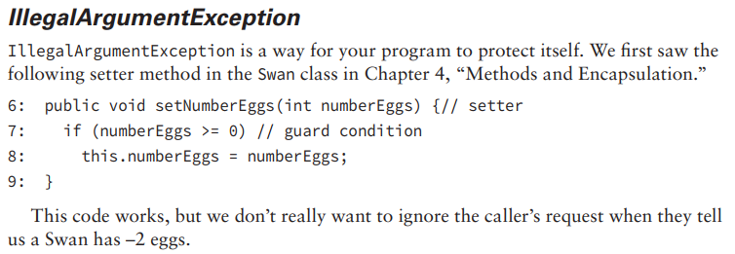
3-Recognizing Common Exception Types

Slide 29
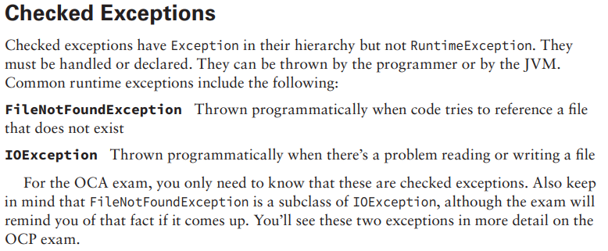
3-Recognizing Common Exception Types

Slide 30
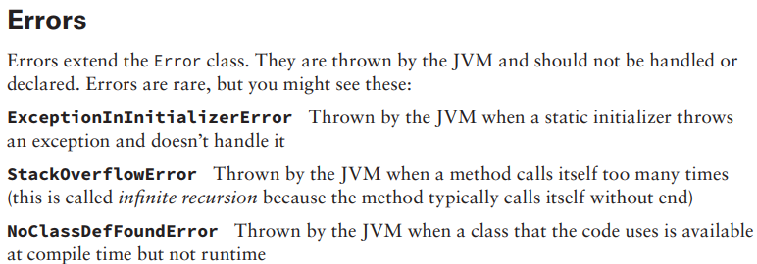
3-Recognizing Common Exception Types

Slide 31
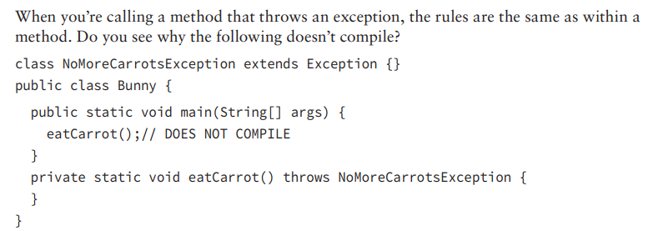
4-Calling Methods That Throw Exceptions

Slide 32
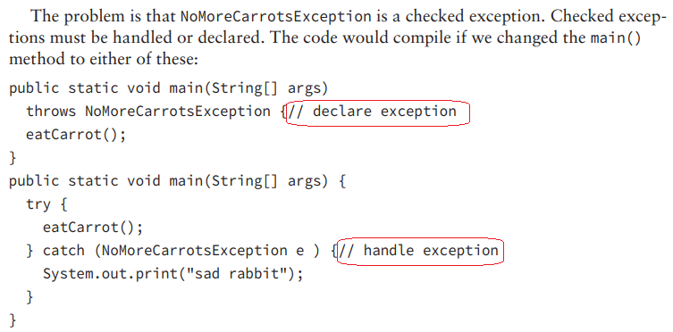
4-Calling Methods That Throw Exceptions

Slide 33
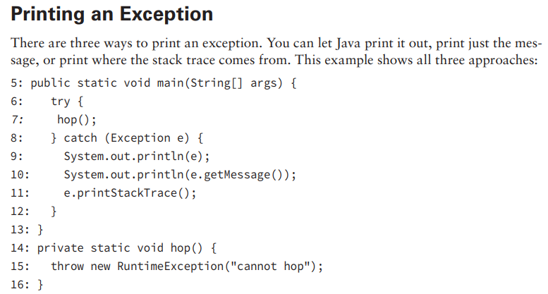
4-Calling Methods That Throw Exceptions

